Slide 1
ReMo Project
Isha Bhanot, Kate Stenberg, Ryan Webb

Slide 2
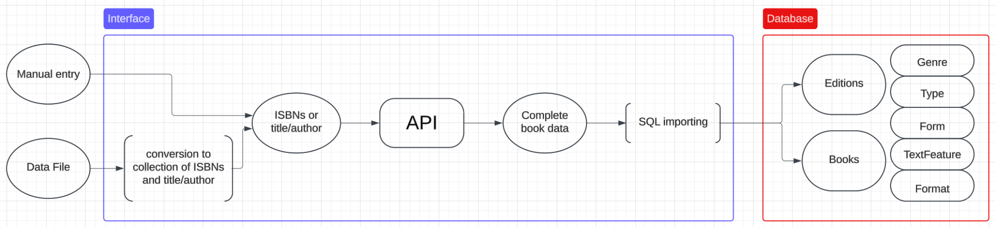
Workflow

Slide 3
Overview
Our project aims to take in book data (either from a mass file or from manual entry of one book’s information) via the GUI and adds it to a database. It does this via an API call, which retrieves more accurate information regardless of the information it came in with, which is not reliable. We have added some basic viewing functionality as well.

Slide 4
Workflow

Slide 5
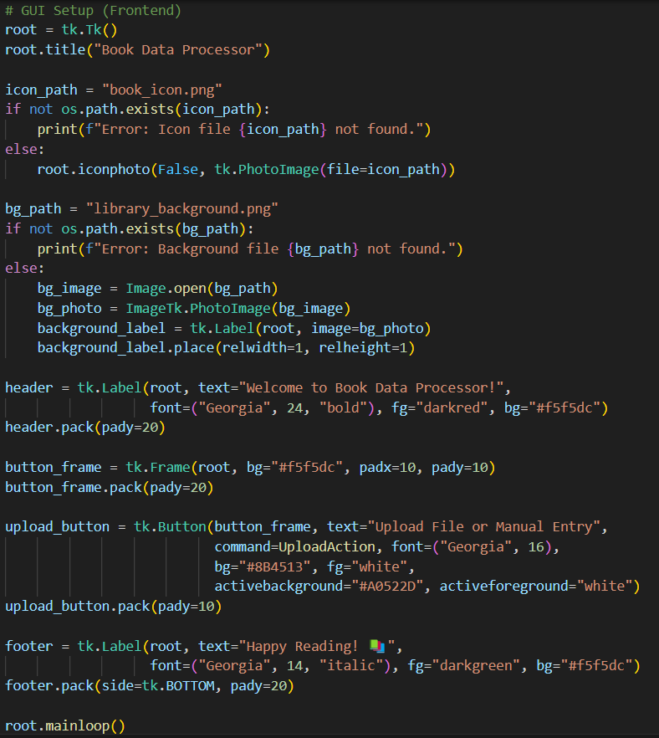
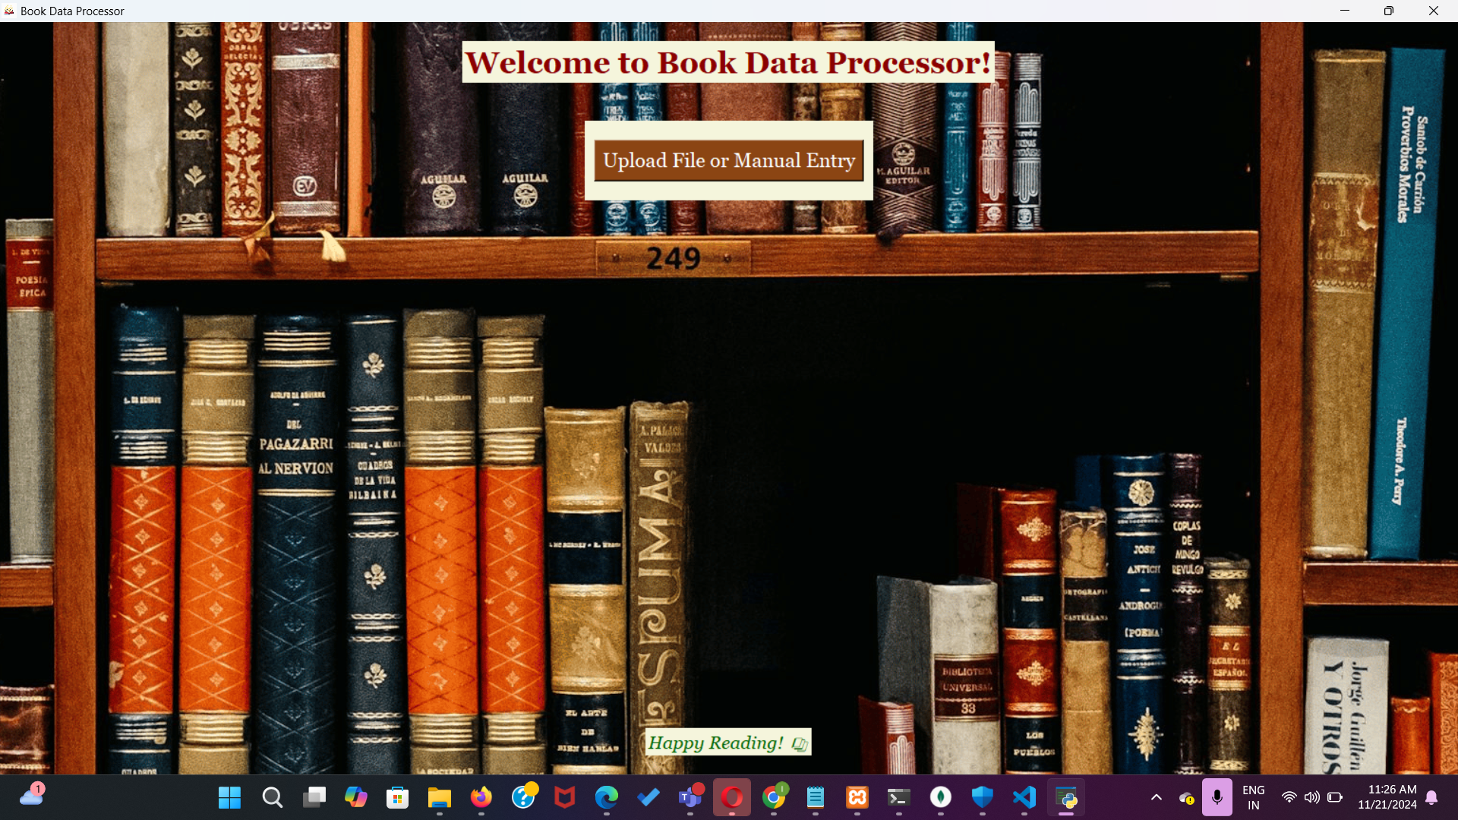

Graphical User Interface

Slide 6
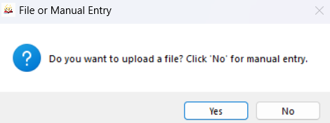
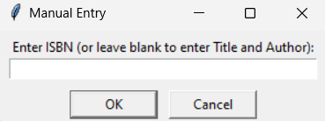
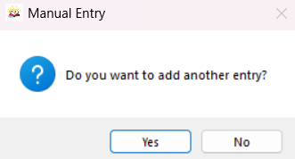
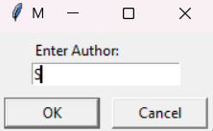
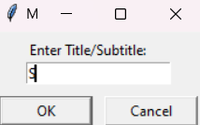
GUI (con’t)

Slide 7
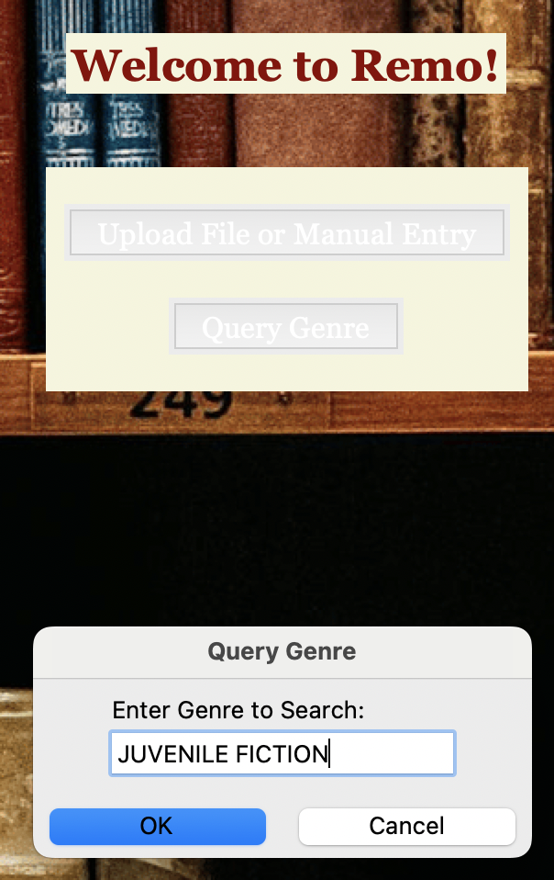
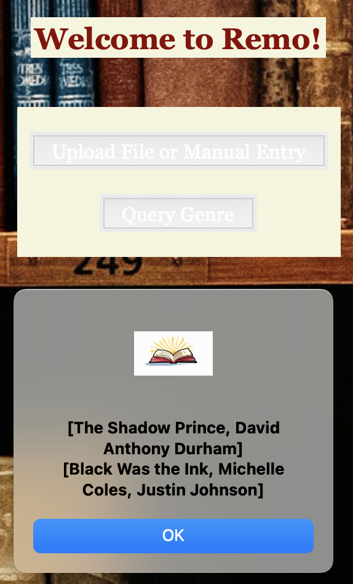
Search for Books based on Attributes
In this case, search for a genre returns the title and author(s).

Slide 8
Workflow

Slide 9
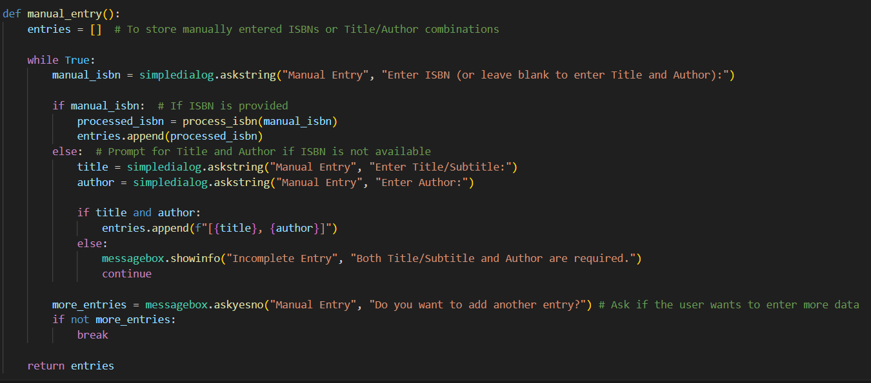
Conversion of entry into ISBNs or titles/authors

Slide 10
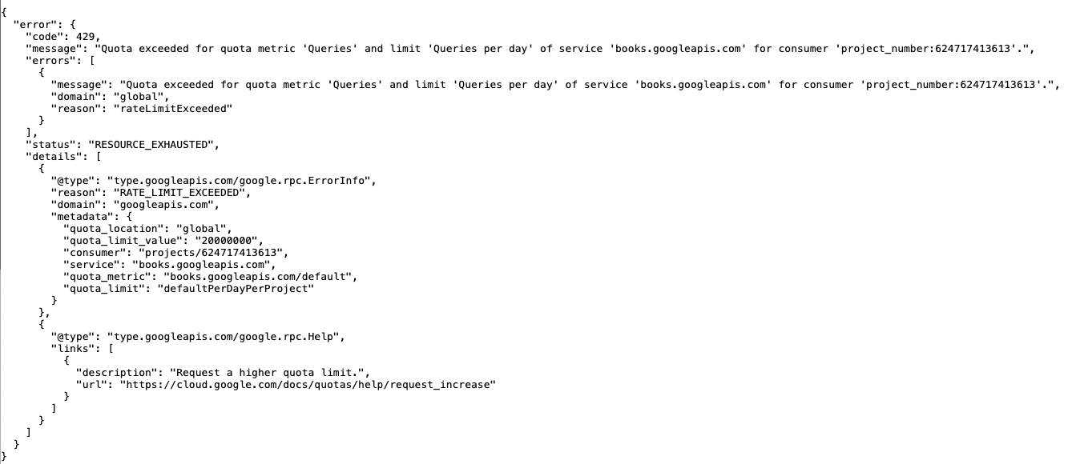
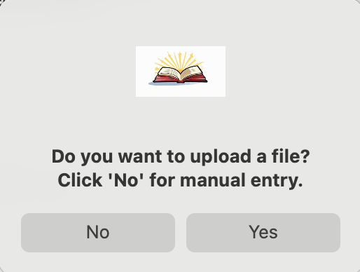
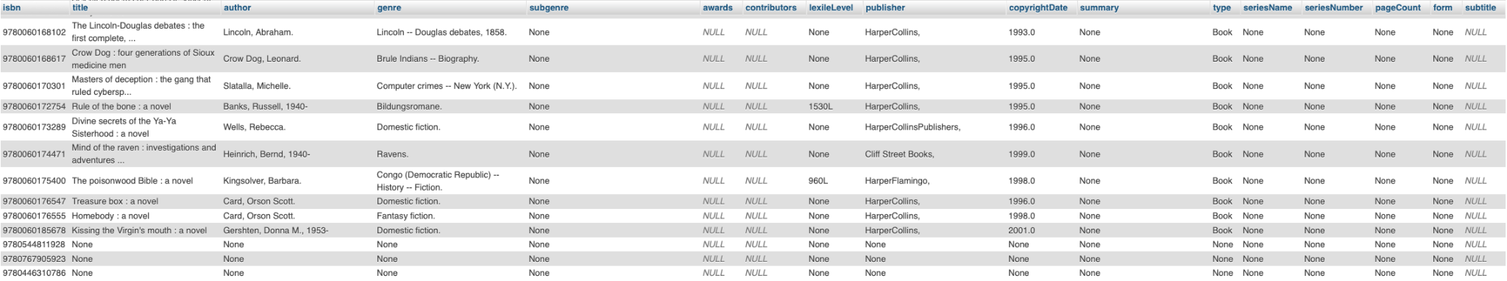
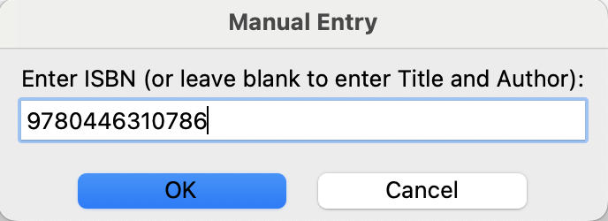
Conversion of entry into ISBNs or titles/authors
We often ran out of free API calls when it came time to add data manually.

Slide 11
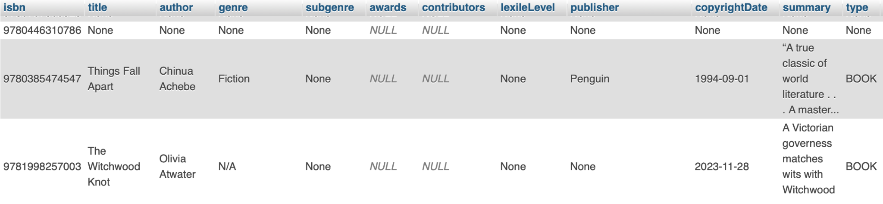
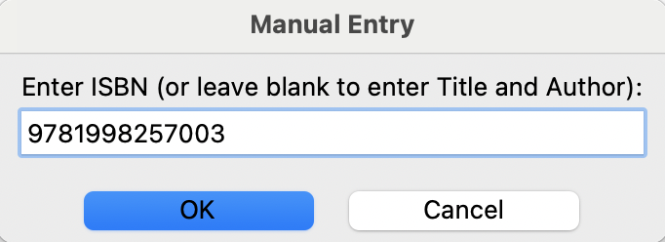
Conversion of entry into ISBNs or titles/authors
We often ran out of free API calls when it came time to add data manually.

Slide 12
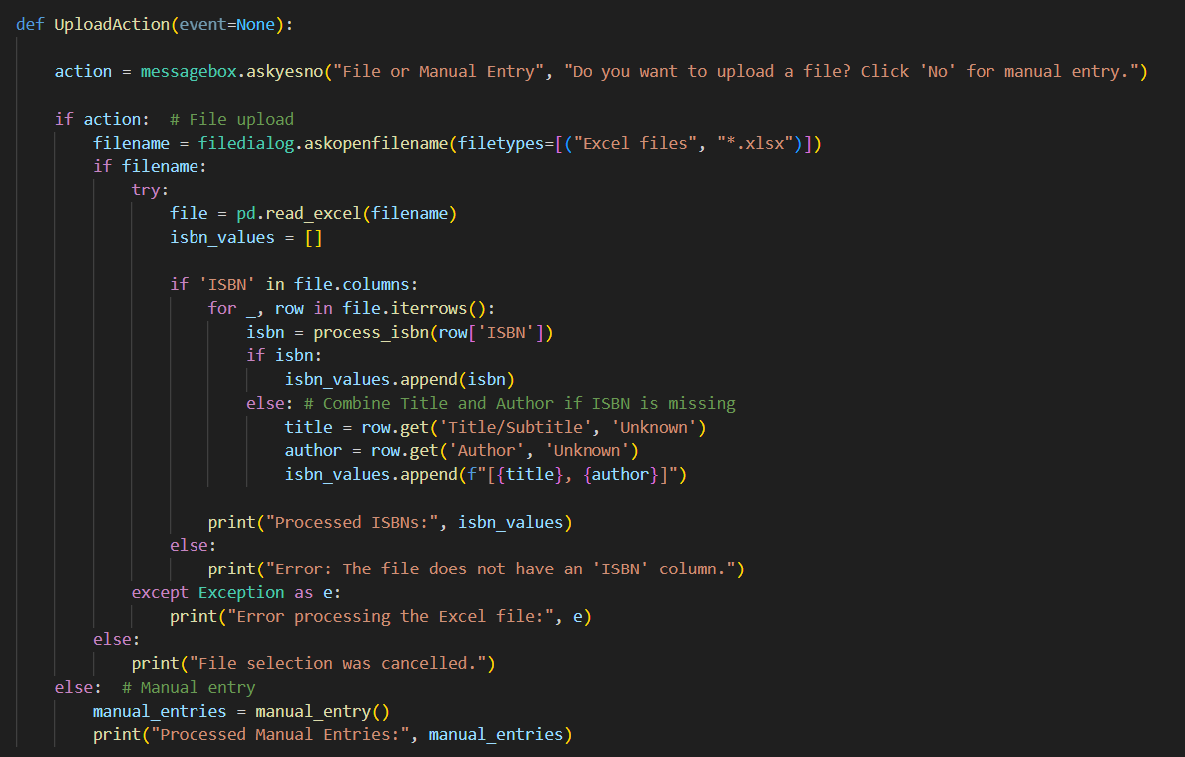
Conversion of entry into ISBNs or titles/authors (File Upload)

Slide 13
Workflow

Slide 14
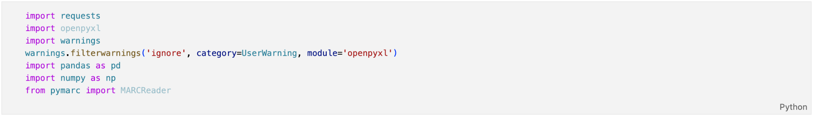
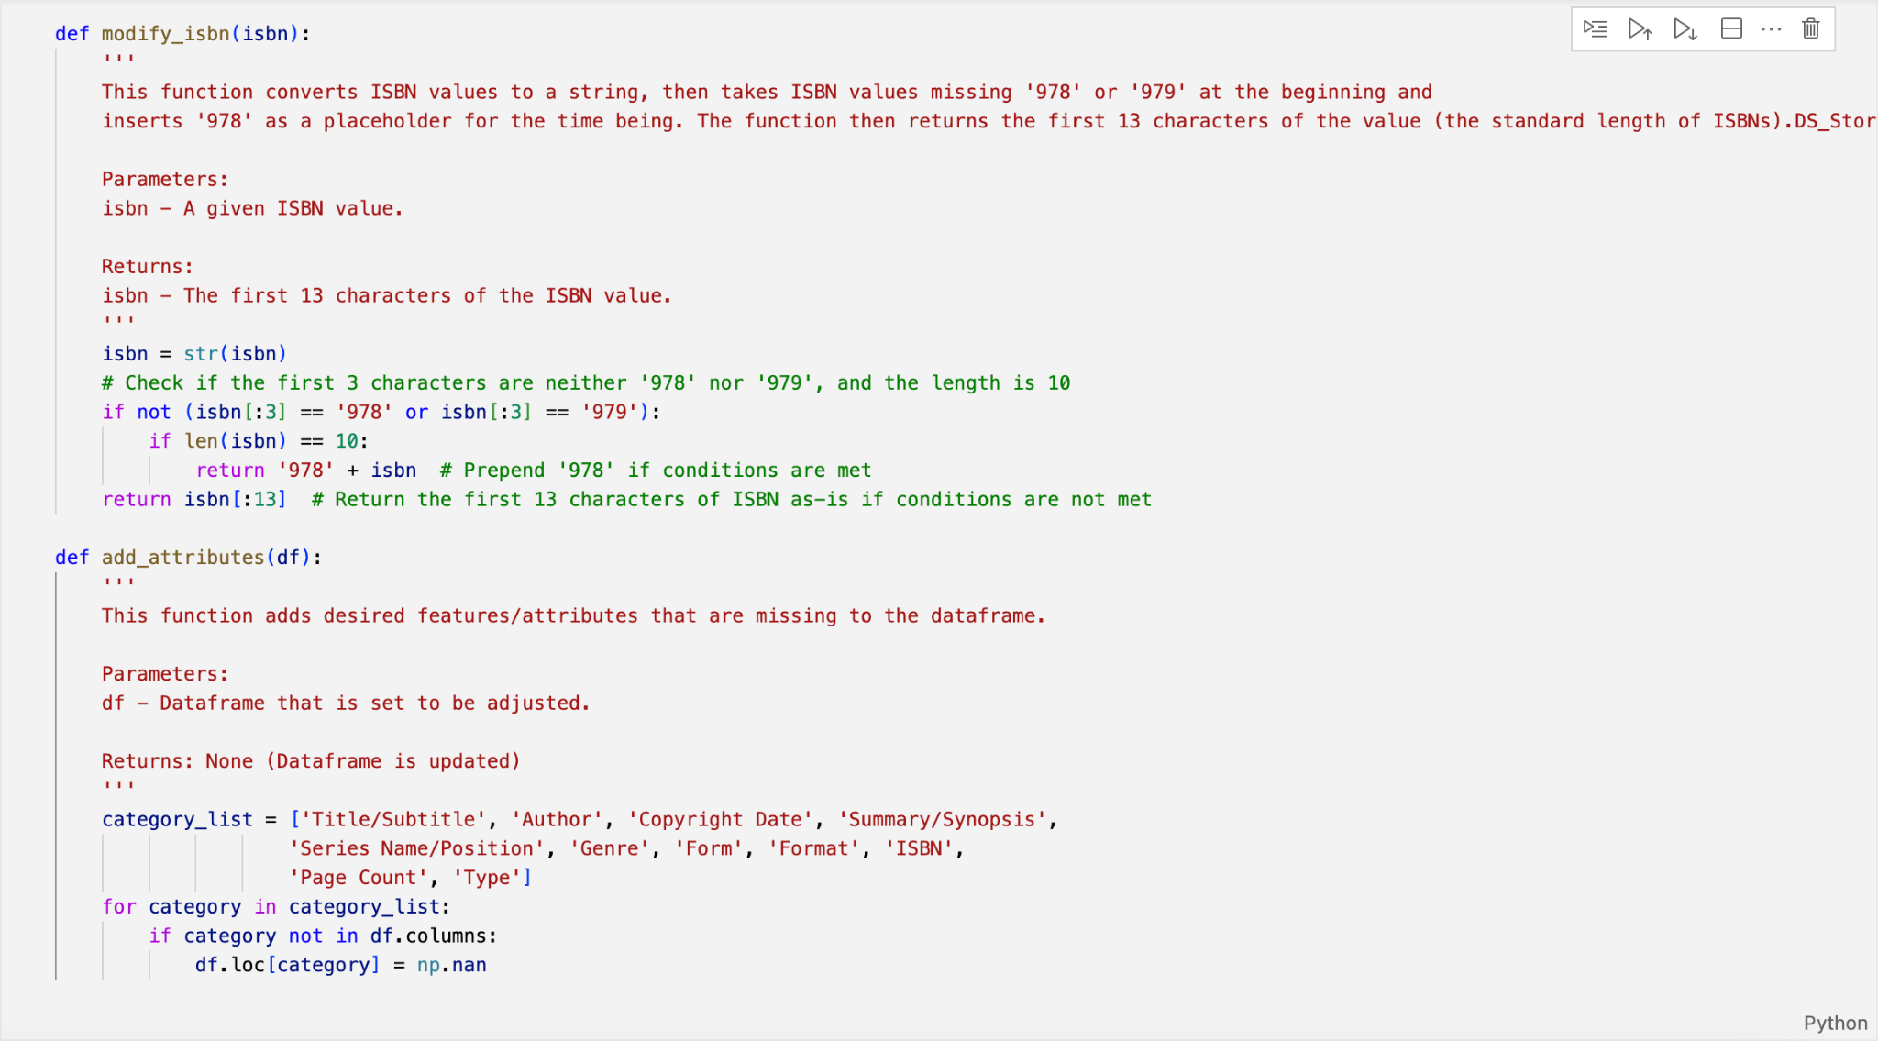
API Call

Slide 15
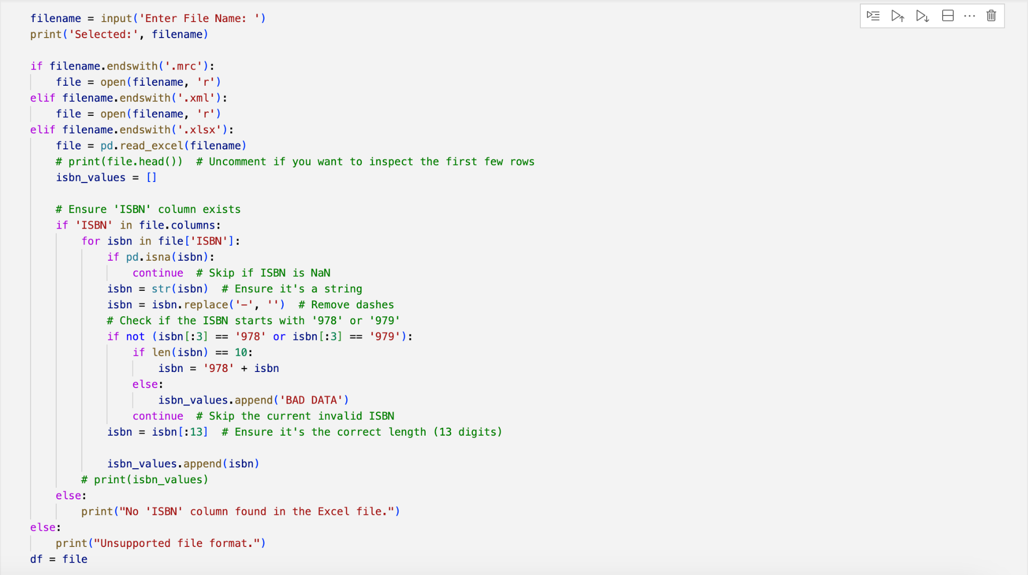
API Call
Take file path →
Conditional file I/O for file types →
Clean ISBN values, currently structured for .xlsx files →
All files will be converted to .xlsx

Slide 16
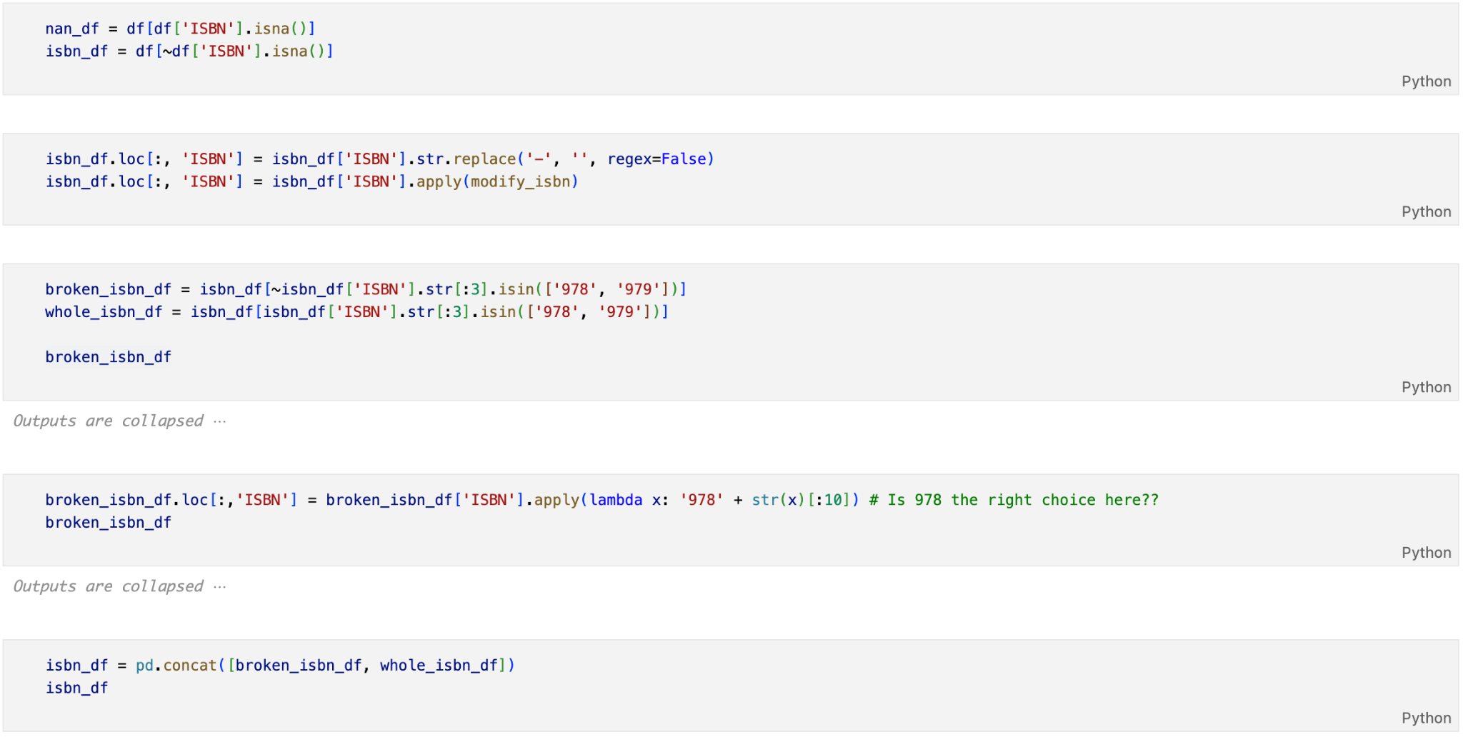
API Call
Separate records with and without ISBNs →
Remove hyphens and modify ISBN values →
Separate correct ISBNs from broken ISBNs →
Apply ‘978’ to beginning of broken ISBNs that are currently length 10 →
Concatenate the (fixed) broken ISBNs and correct ISBNs →
Convert df to strings for the time being →

Slide 17
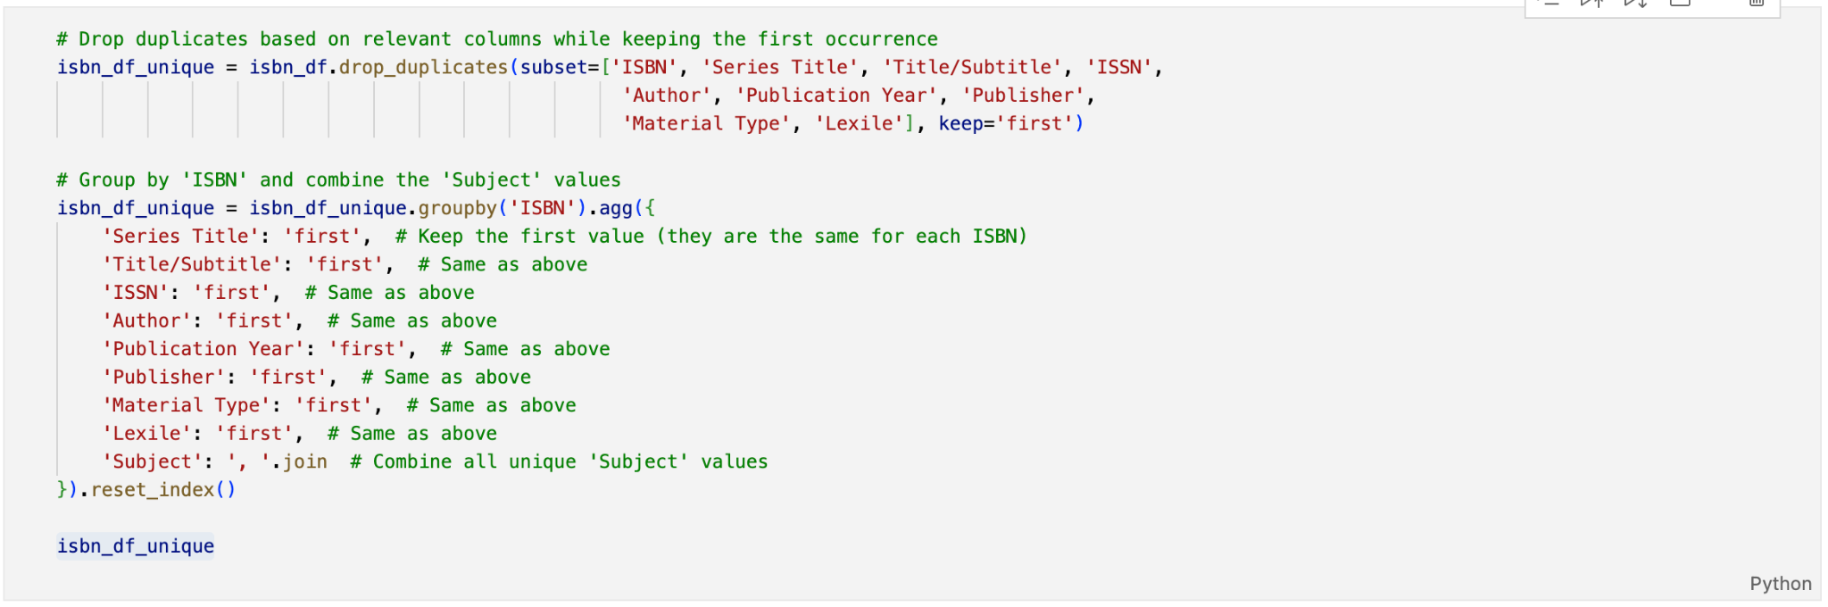
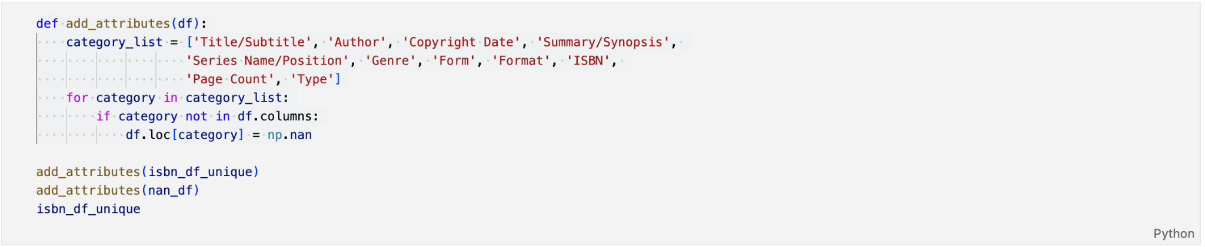
API Call
Handling duplicate rows
that have the same values,
except for ‘Subject’
Add missing attributes or
features that are necessary
to the data

Slide 18
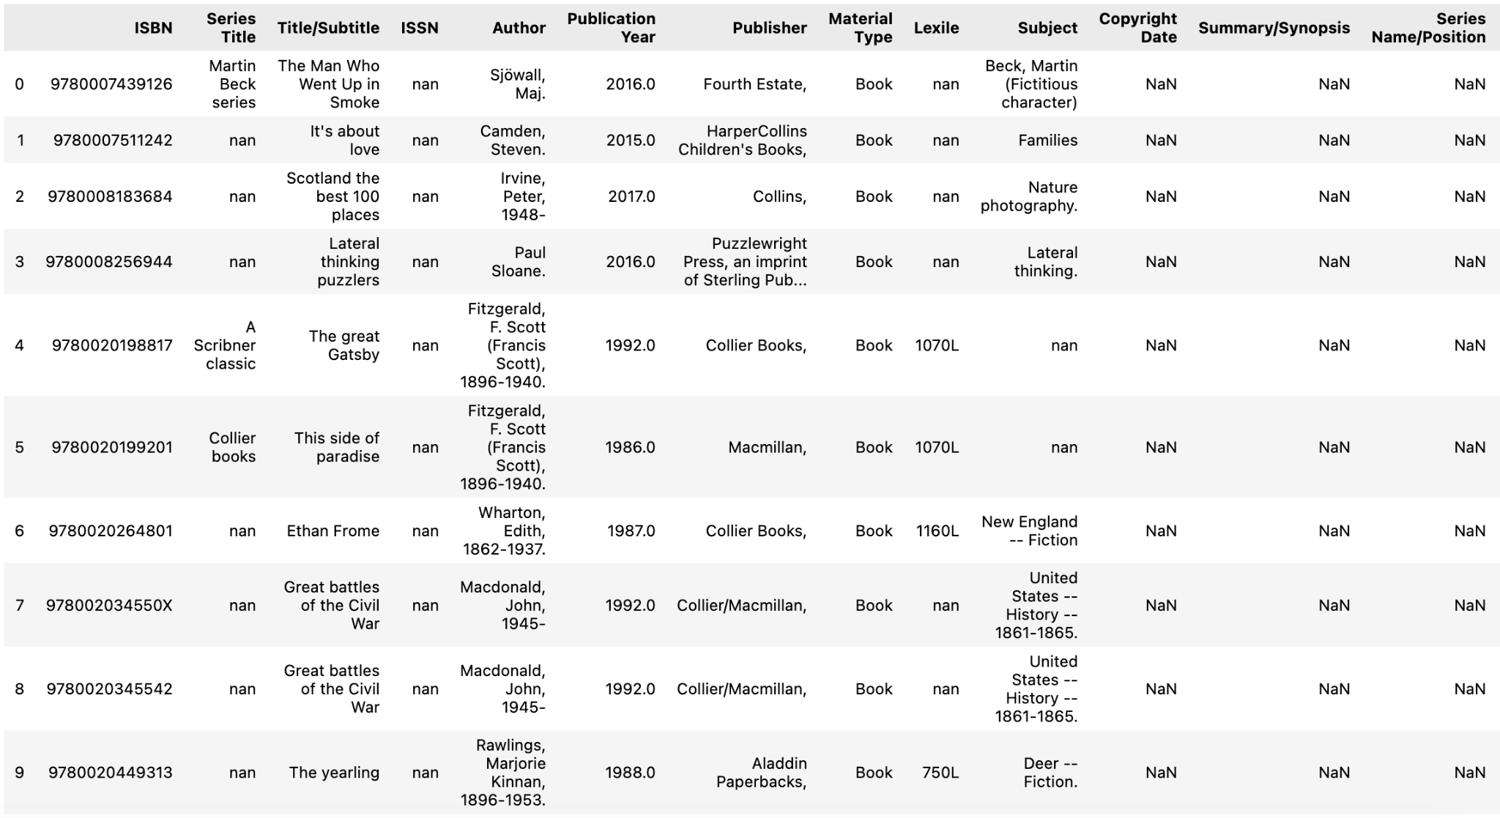
API Call
Short version of the dataframe
for testing/example

Slide 19
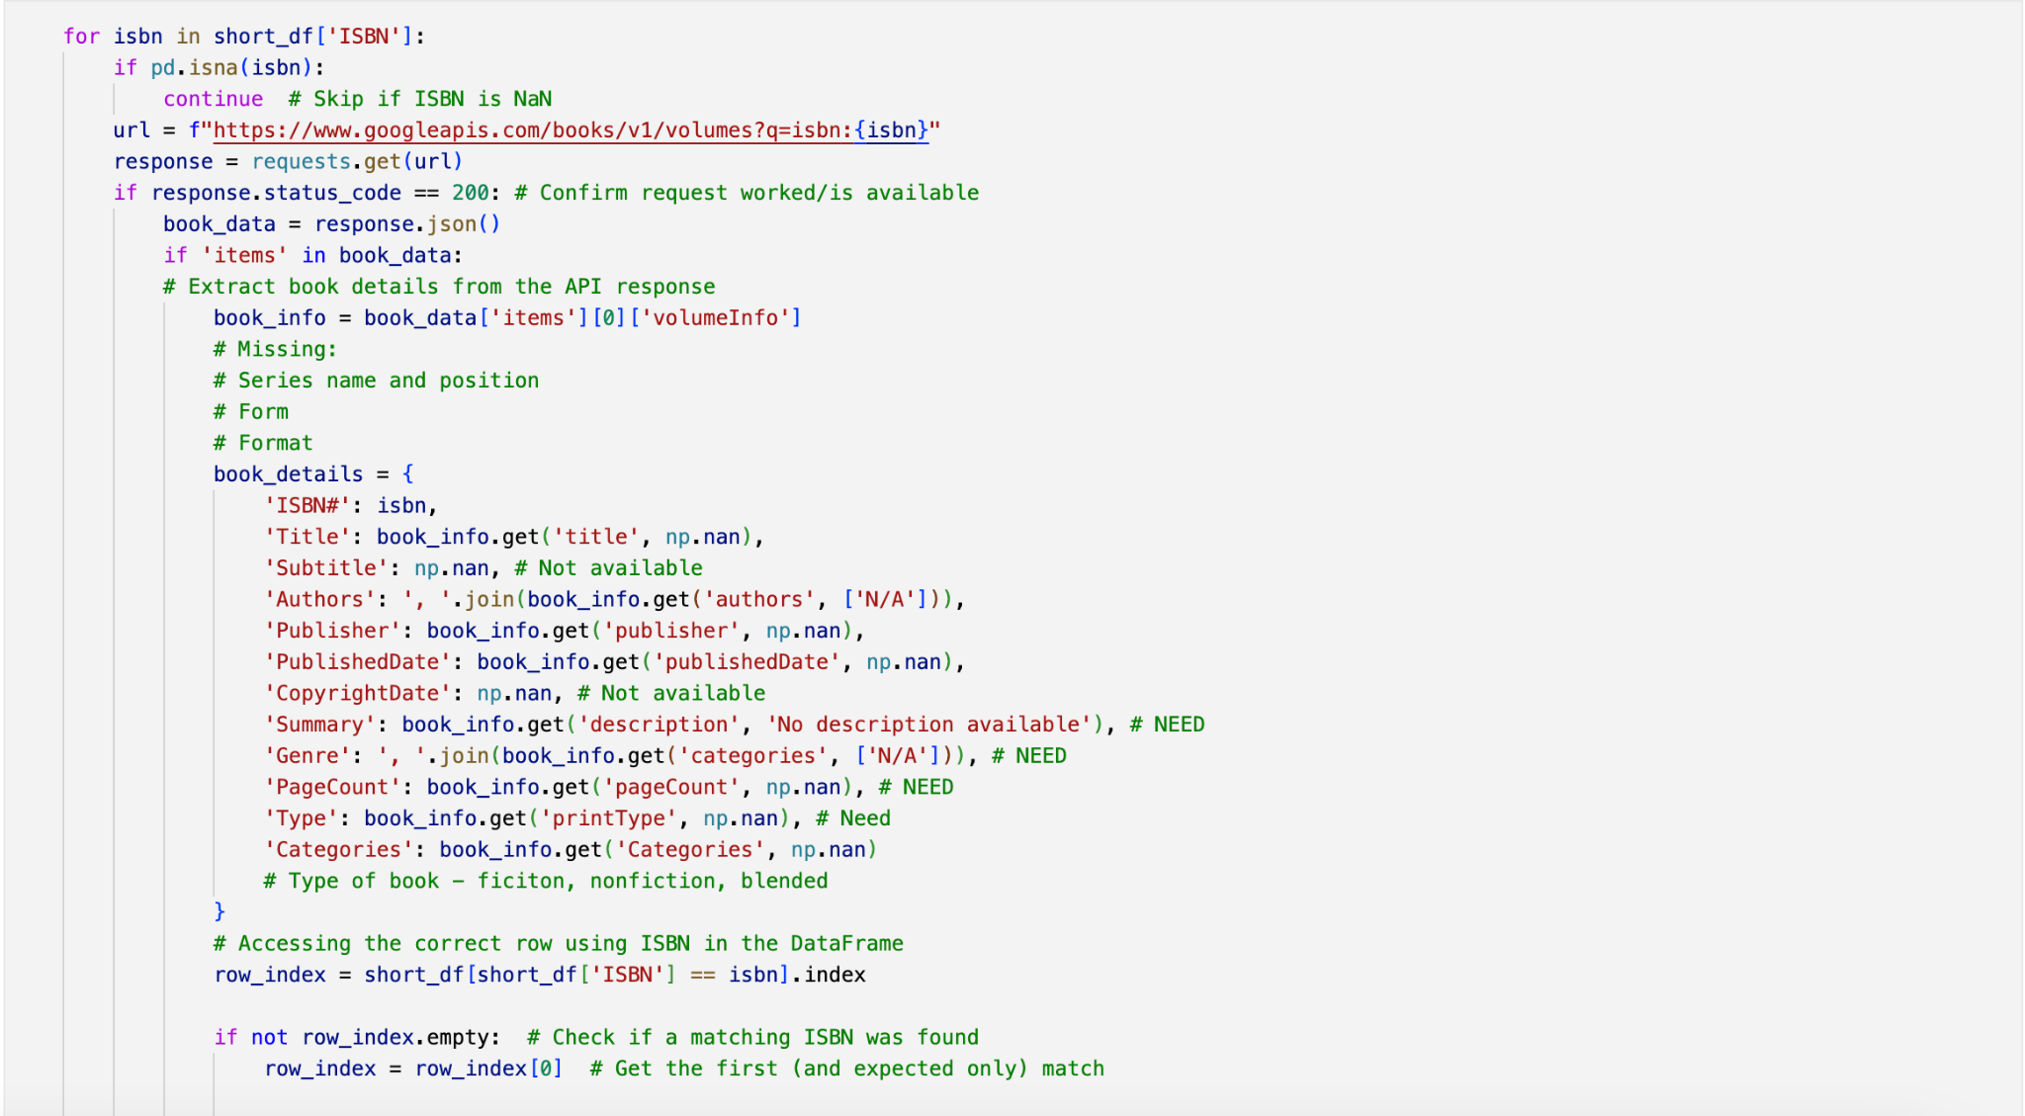
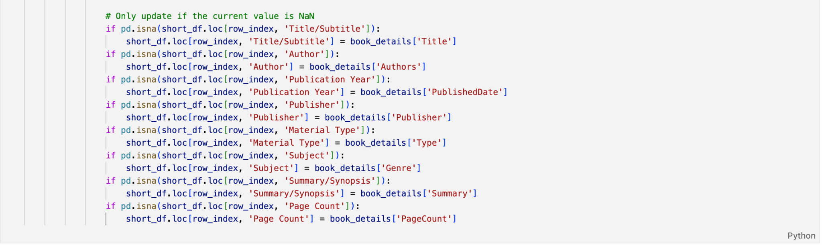
API Call
Iterate through all ISBNs in dataframe, and call
the Google Books API by ISBN.
Take the available book data from this request
relevant to desired data
Populate missing data from original .xlsx in the
dataframe

Slide 20
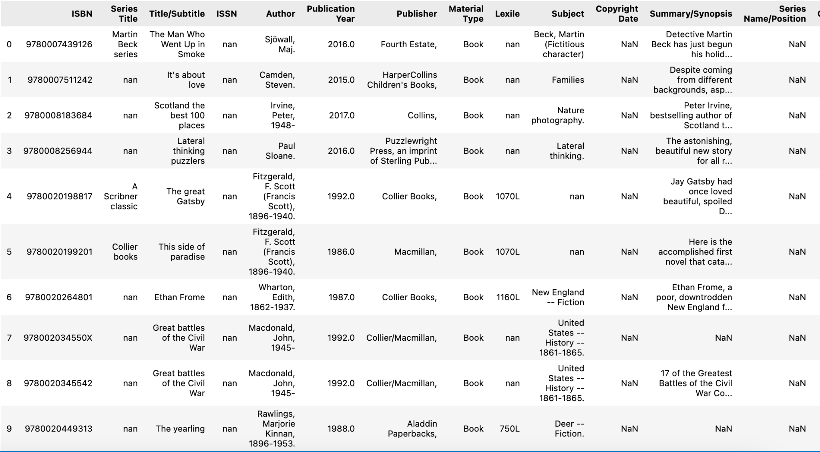
API Call
Before: After:
This does not rescue all missing values, but gives us more complete data.
Concatenate data following API
call with data missing ISBN.

Slide 21
Workflow

Slide 22
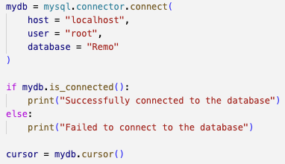
DataFrame to SQL Database
To write data from the dataframe to the database, we connect to the database and initialize a cursor as follows:

Slide 23
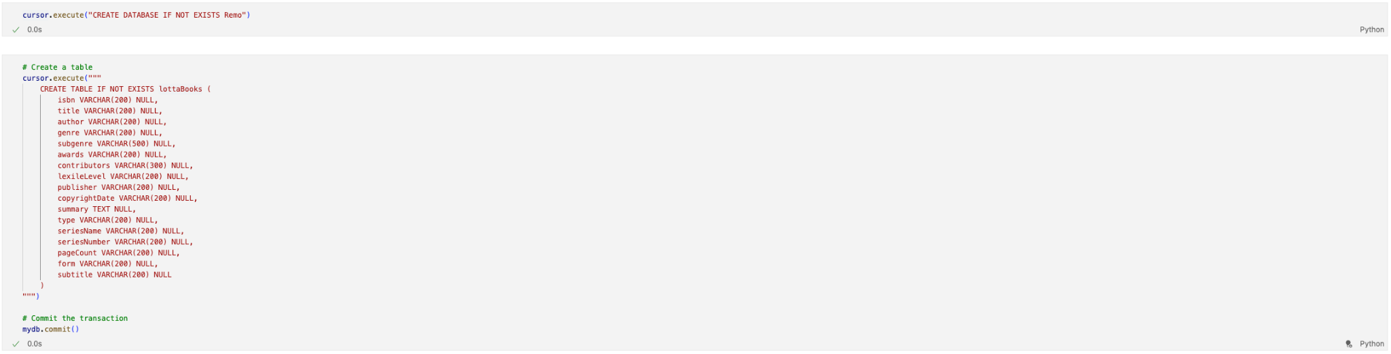
Writing to the SQL DB (CREATE)

Slide 24
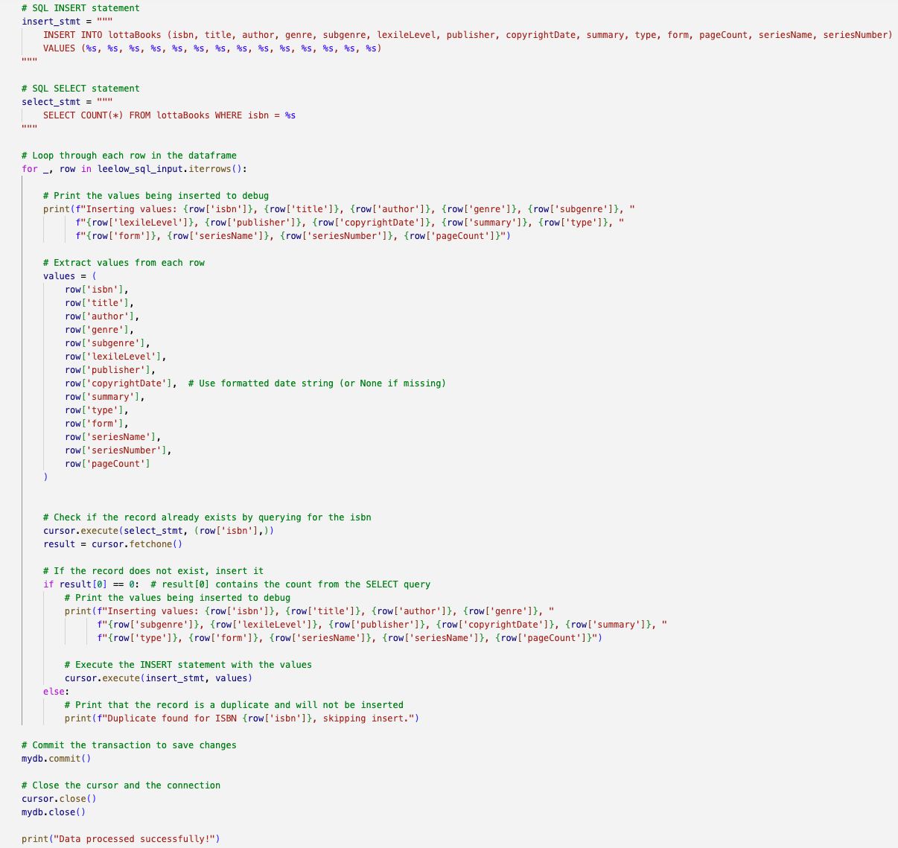
Writing to the SQL DB (INSERT)

Slide 25
Workflow

Slide 26
Database
Our database comprises one table with each entry specifying a unique book.

Slide 27
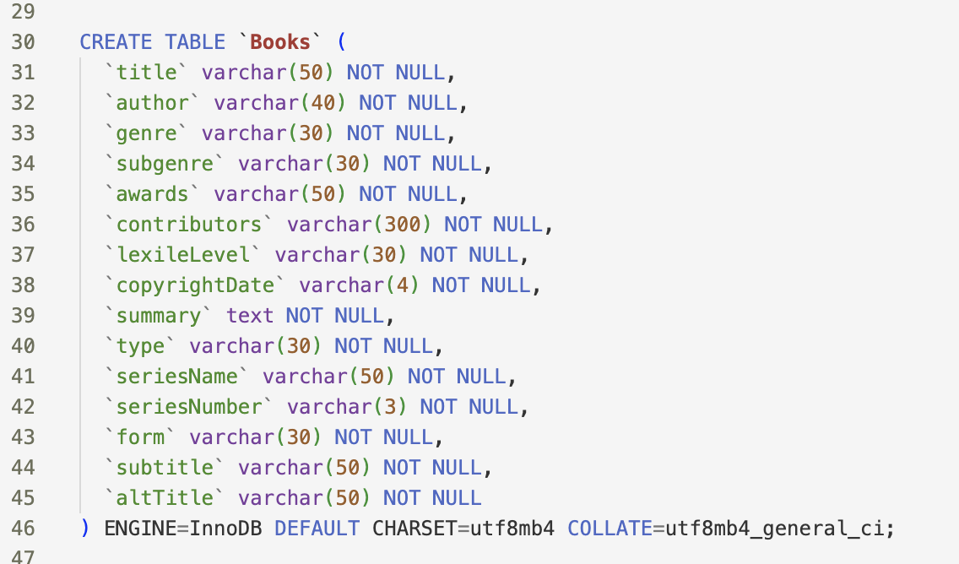
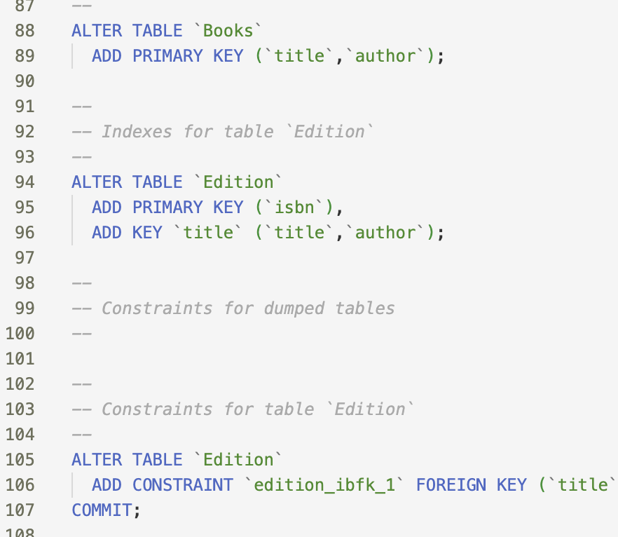
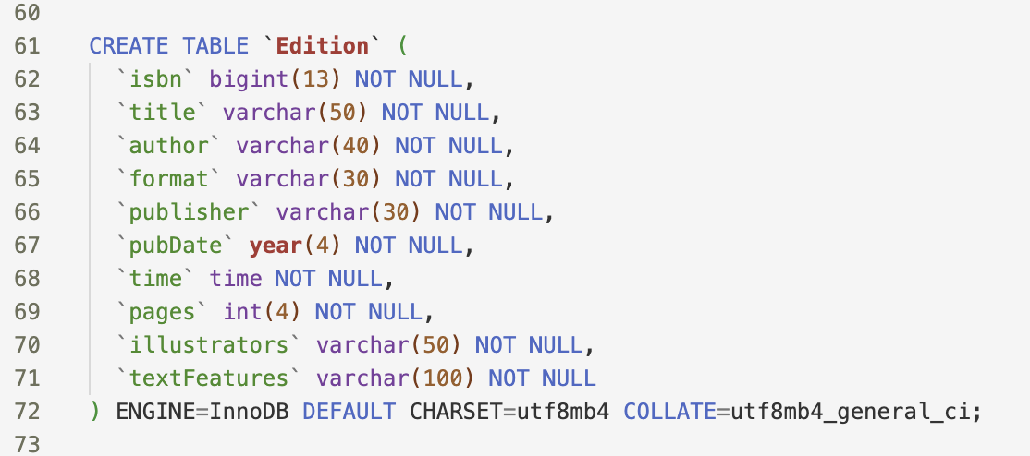
Database

Slide 28
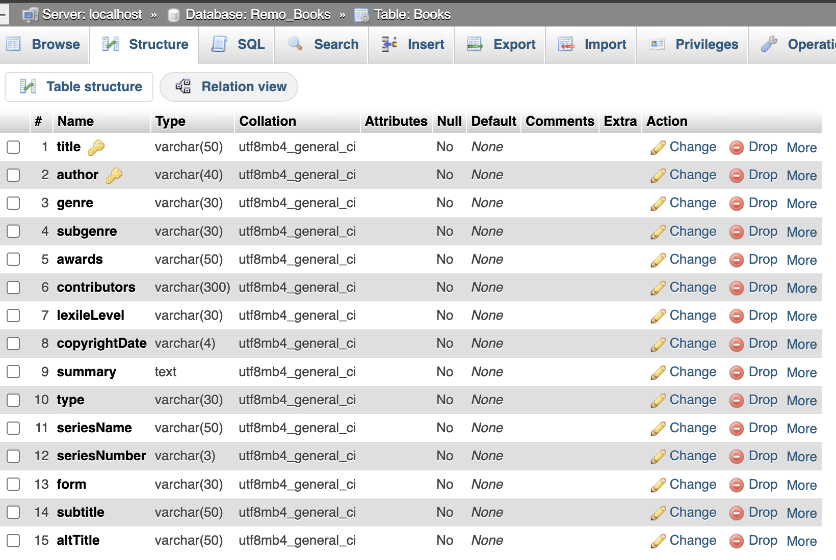
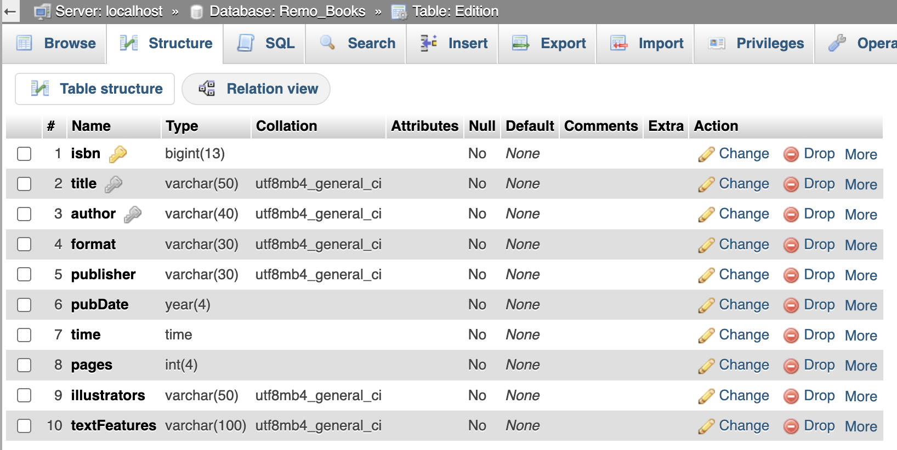
Database - in phpmyadmin

Slide 29
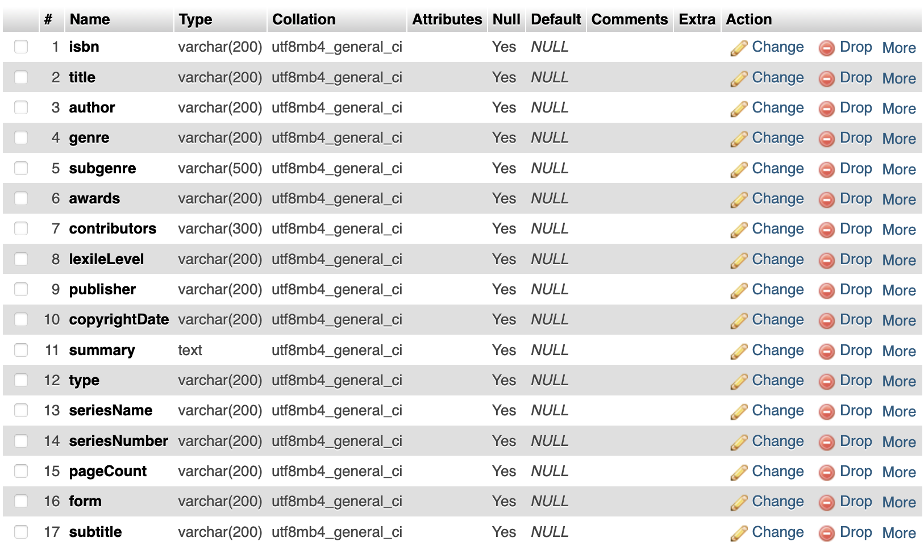
Database (phpMyAdmin)
We left a lot of flexibility in the attributes due to inconsistent, messy data.

Slide 30
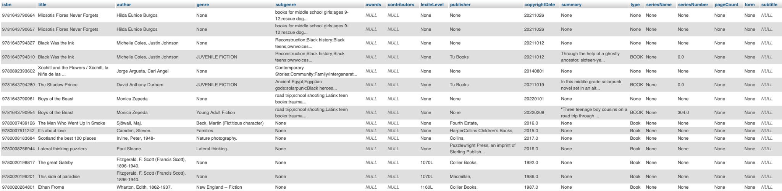
Database (phpMyAdmin)

Slide 31
Next Steps
Graphical User Interface:
Build out the interface to directly interact with the database.
Consider allowing for manual data entry/updates.
Data Manipulation and API Call:
The pipeline is built for .xlsx files, but ReMo has .xml files and .mrc files which aren’t as easily interpreted. We plan to convert these to .xlsx files that will fit into our pipeline, or worst case, scrape ISBN values from these files.
Coordinate the dataframe output to match cleanly with the database.
Investigate further API calls to fill missing data.
Consider “new” records with books that already exist in the database coming in from additional files and/or manual entry.
Database:
Use pandas.DataFrame.to_sql to load data to database.
Potentially adjust the structure of the database depending on the information we can populate from the data files and API calls.

Slide 32
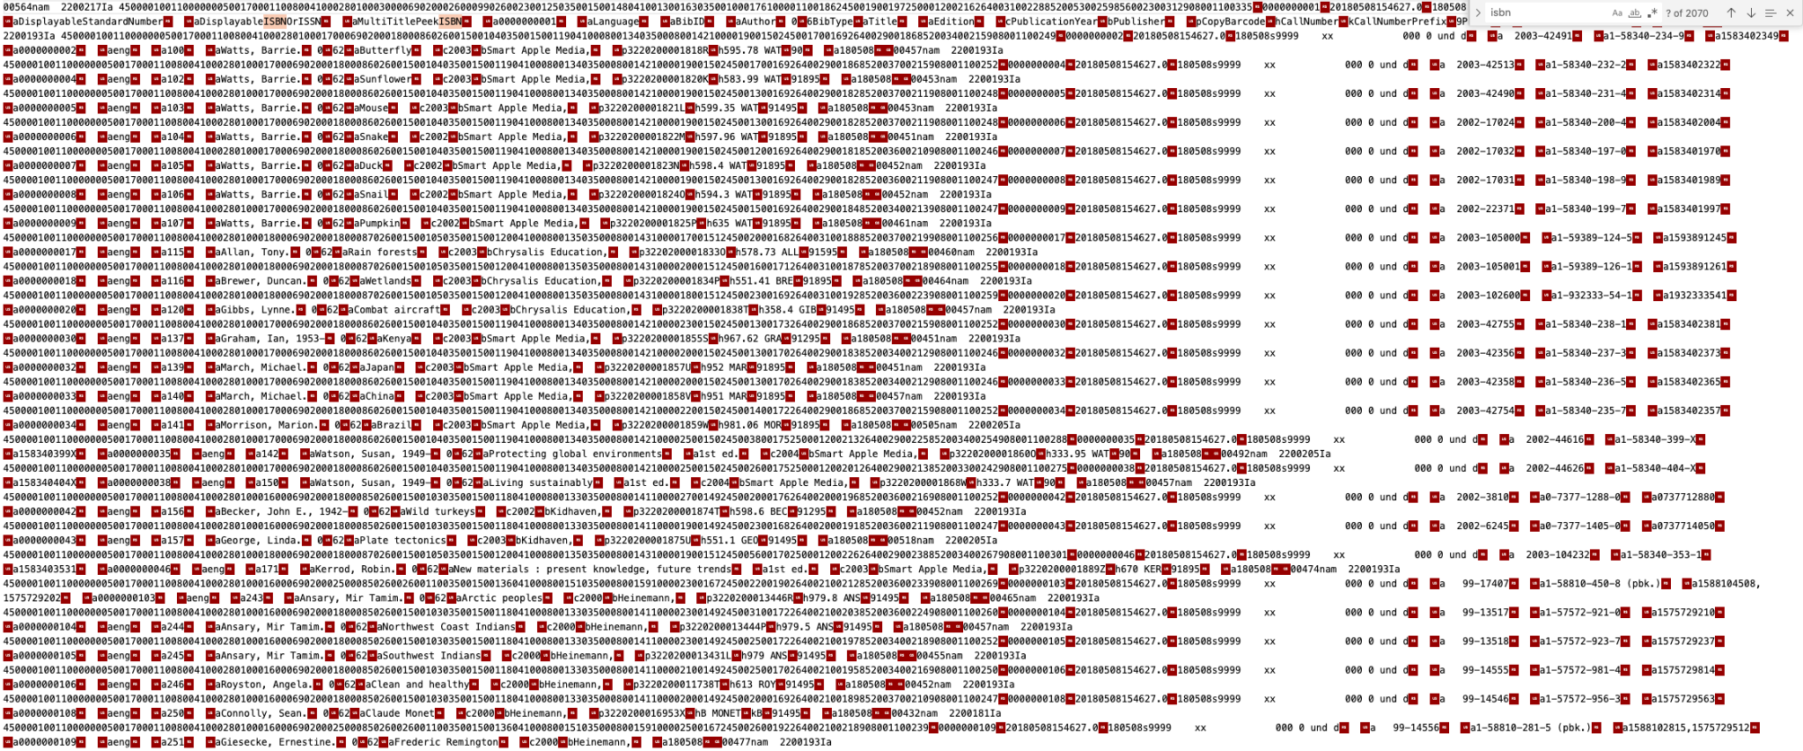
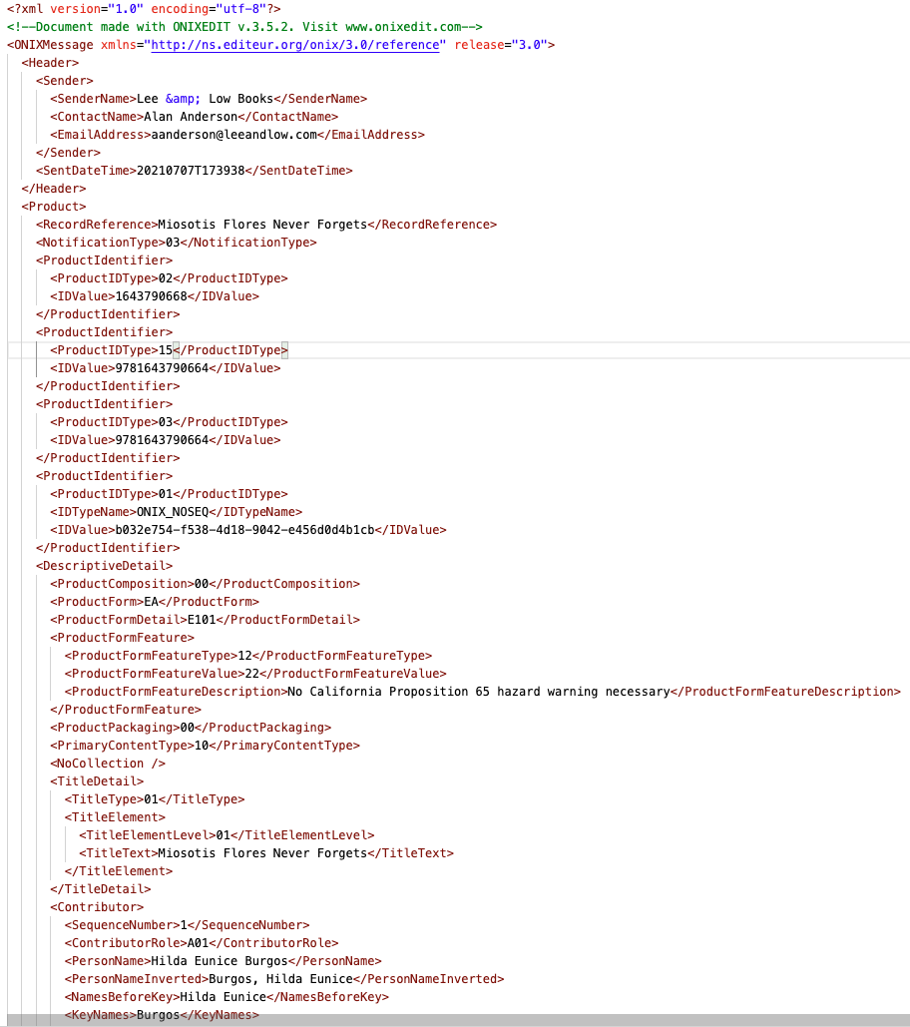
Challenges
XML
Creating a uniform pipeline for file intake
Multiple file types (MRC, XML, XLS, etc).
MRC
Used back door ability of Zotero to convert MRC to .csv, not scalable.
Needed decompiling with NodeJS.
XML
Varied in structure and need specific details to read, not scalable.
Within file types, files have different headings and data, so they need to be processed differently.

Slide 33
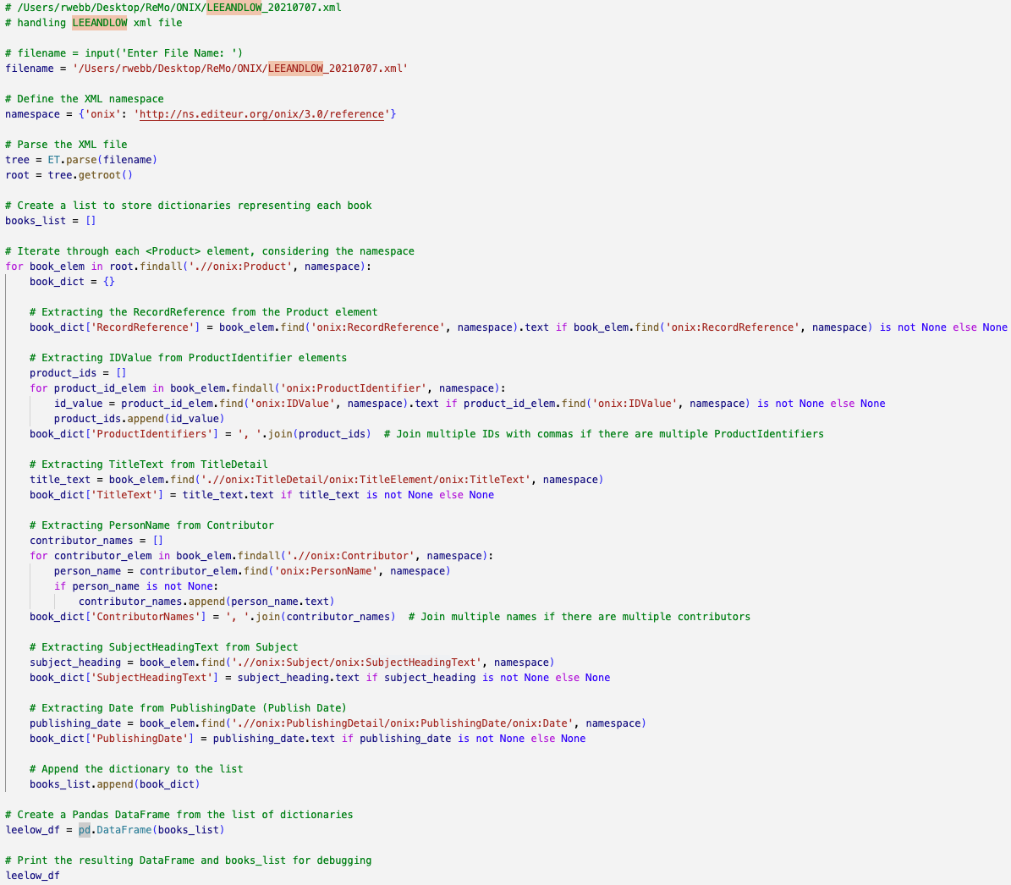
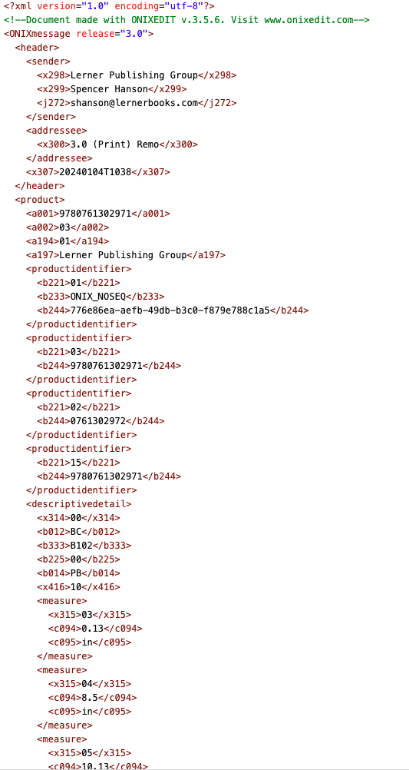
XML

Slide 34
Challenges
Creating a uniform pipeline for file intake
Multiple file types (MRC, XML, XLS, etc).
Within file types, files have different headings and data, so they need to be processed differently.
Data requested by the client was often unavailable
Data within files is sparse and does not conform to desired categories.
APIs were not entirely helpful in filling in missing data, they were also limited in our ability to use them:
Cleaning each of the larger data files had a run time of >25 minutes per file
A significant manual and automated effort was needed to convert each file into a standardized format.
Some of the files couldn’t be entered into the DB due to size limitations in phpMyAdmin.

Slide 35
Path Forward
Expanded functionality allowing users to find and enter more data from the interface.
Ability to look up books.
Ability to modify records and input additional data for sparse records.
Different accesses for Student, Teacher, and Admin.
Setting a standard data format for participating schools/resources.
Book data is itself messy with many overlapping attributes between records (titles, authors, even ISBNs in some cases).
The manual lift required to handle each individual file will cause a challenge without standards. We suggest .xlsx files as these are the easiest to manage with our current pipeline using Python, generating DataFrames, and entering records into a SQL database.

Slide 36
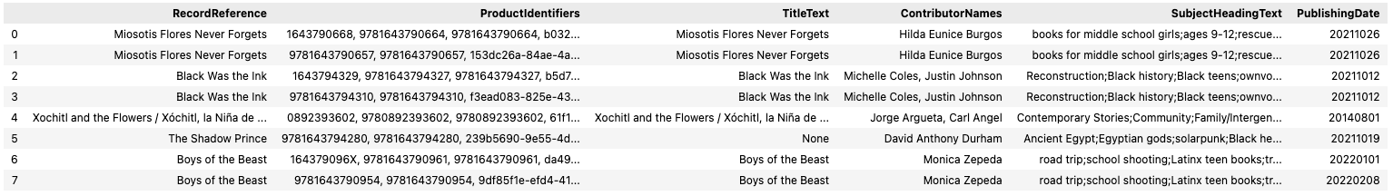
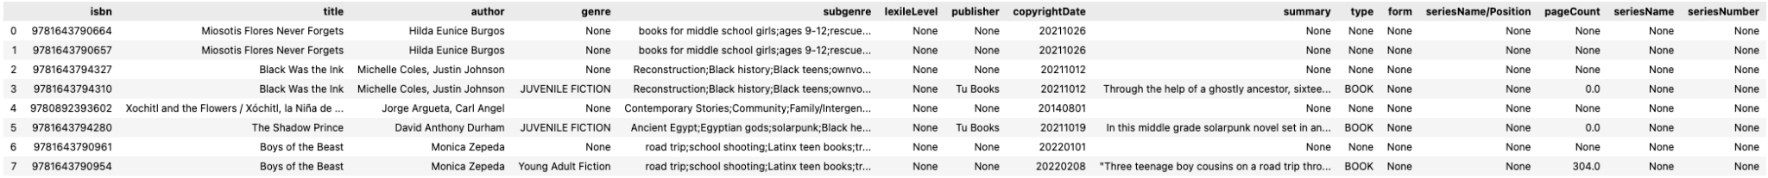
Conceptual “Gold Standard” for Data
This “raw data” in the dataframe required reading the XML and determining which data to extract. Similarly, MRC files required a lot of weeding out “excess” data.
Getting here takes a lot of preprocessing and cleaning for each individual file, and even still a lot of data is missing.

